Slide 1


Mansoura University Faculty of Computers and Information Second Semester- 2020-2021
COMPUTER GRAPHICS
Grade: 2ND YEAR (GENERAL –BIO)
Prepared by: Dr. Haitham El-Ghareeb,
Dr-Waleed Mohamed Dr-Ibrahim El-Hasnony,

Slide 2


Slide 3
Chapter 1
introduction

Slide 4
REASONS TO STUDY CG
Better information presentation
Job in computer graphics (games, movies, etc)
New medium for artistic expression
Communicate ideas better
Get a grade??

Slide 5
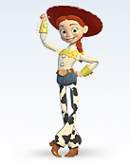
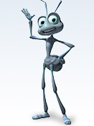
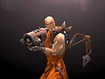
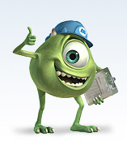
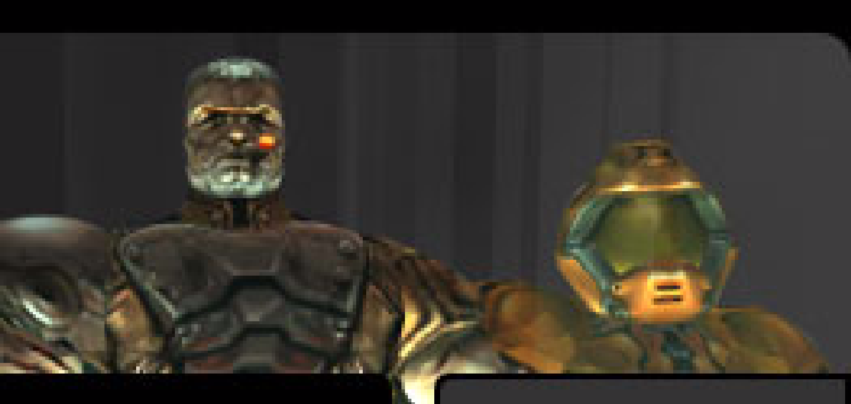
USES OF COMPUTER GRAPHICS
Art, entertainment, publishing:
movies, TV, books, magazines, games

Slide 6
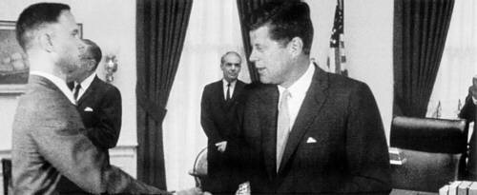
USES OF COMPUTER GRAPHICS
Image processing:
alter images, remove noise

Slide 7
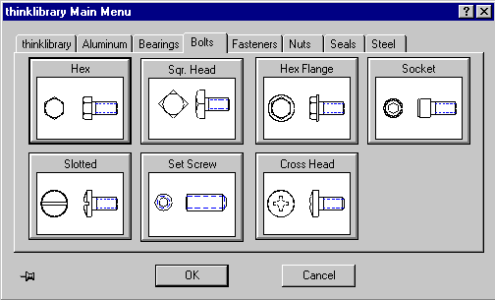
USES OF COMPUTER GRAPHICS
Computer-aided design:
architecture, electric circuit design

Slide 8
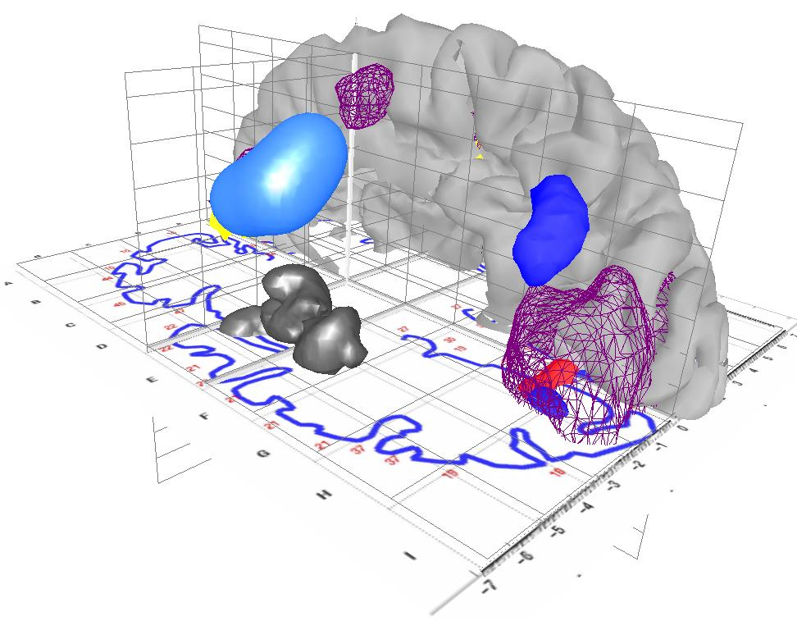
USES OF COMPUTER GRAPHICS
Scientific analysis and visualization:

Slide 9
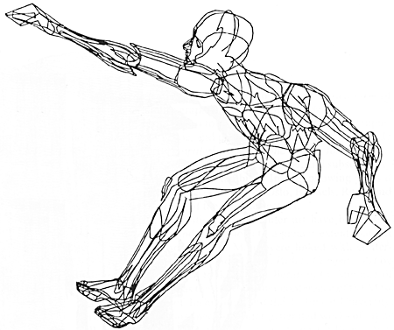
CG DEFINITION
Computer graphics
Computer graphics generally means creation, storage and manipulation of models and images
Functions/routines to draw line or circle, etc
Such models come from different set of fields including physical, mathematical, artistic, biological, and even conceptual (abstract) structures.
William Fetter coined term “computer graphics” in 1960 to describe new design methods that create a series of widely reproduced images on “pen plotter” exploring cockpit design, using 3D model of human body.

Slide 10
CG DEFINITION
What is computer graphics (CG)?
Computer graphics is an art of drawing pictures, lines, charts, etc. using a computer with the help of programming. Pixel is the smallest addressable graphical unit represented on the computer screen.
Image represented as a 2D grid of “pixels” (picture elements) -Each pixel can take on a unique color value (Fig. 1)
At a minimum, there is 1 memory bit for each pixel in the raster. This amount of memory is called a bit plane.

Slide 11
COMPUTER GRAPHICS, BY WILLIAM A. FETTER, 1966
“Perhaps the best way to define computer graphics is to find out what it is not.
It is not a machine. It is not a computer, nor a group of computer programs.
It is not the know-how of a graphic designer, a programmer, or a motion picture specialist.
Computer graphics is all these – a managed and documented technology directed toward communicating information accurately and descriptively.”

Slide 12
FOUR MAIN OPERATIONS OF COMPUTER GRAPHICS
Image Editing
3D Modeling
2D Rendering
Animation

Slide 13
IMAGE EDITING
Image Merging
Change Color
Image Cropping
Image Orientation

Slide 14


IMAGE EDITING
image Merging
Change Color
Image Cropping
Image Orientation

Slide 15
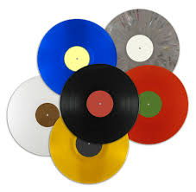
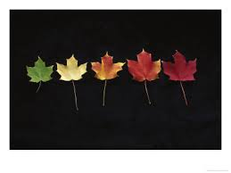
IMAGE EDITING
image Merging
Change Color
Image Cropping
Image Orientation

Slide 16
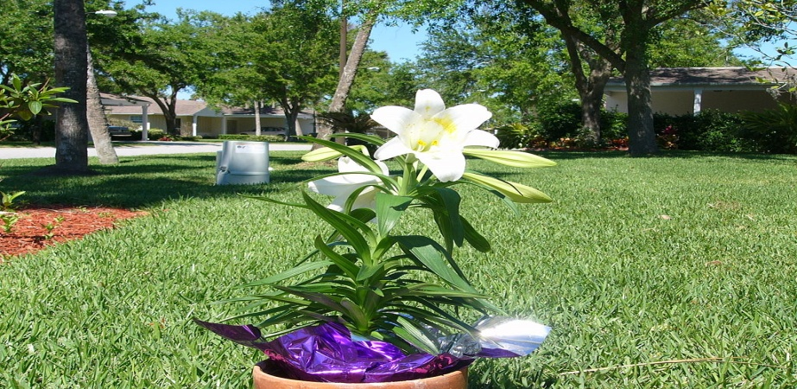

IMAGE EDITING
image Merging
Change Color
Image Cropping
Image Orientation

Slide 17
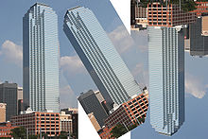
IMAGE EDITING
image Merging
Color Changing
Image Cropping
Image Orientation

Slide 18
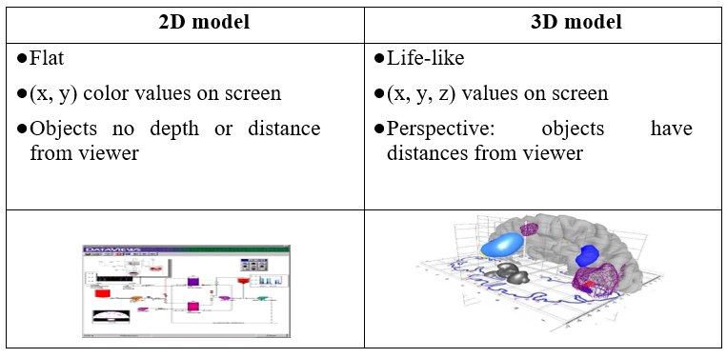
2D VS. 3D

Slide 19
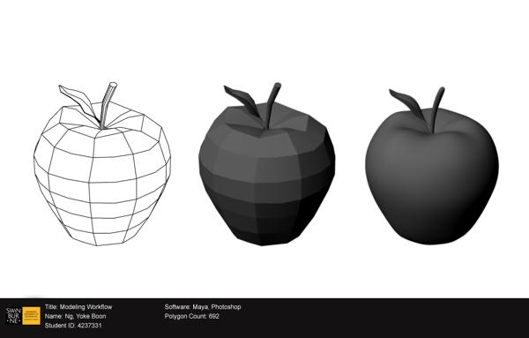
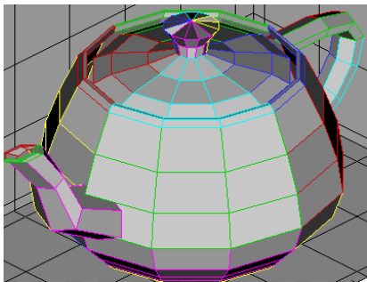
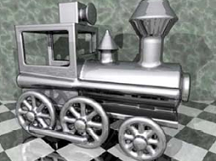
3D MODELING
Represents a 3D object using a collection of points in 3D space, connected by various geometric entities.
How to represent real environments
Geometry: Lines, triangles, curves, surfaces, Cylinder, spheres
Photometry: light, color, shadow

Slide 20
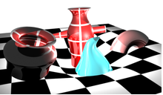
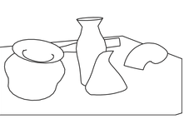
2D RENDERING
2D Rendering is the opposite operation of 3D modeling process ,
it is responsible of generating 2D image from a model or 3D image

Slide 21
CREATING 3D
Start with 3D shapes (modeling)
Basic shapes(cube, sphere, etc), meshes, etc
Scale them (may also stretch them)
Position them (rotate them, translate, etc)
Then, render scene (realism)
Perspective
Color and shading
Shadows
Texture mapping
Transparency and blending
Practical note: modeling and rendering packages being sold (Maya, 3D studio max, etc)

Slide 22
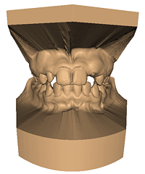

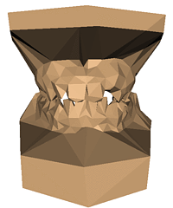
3D MODELING EXAMPLE: POLYGONAL MESH
Original: 424,000 triangles
60,000 triangles (14%).
1000 triangles (0.2%)

Slide 23
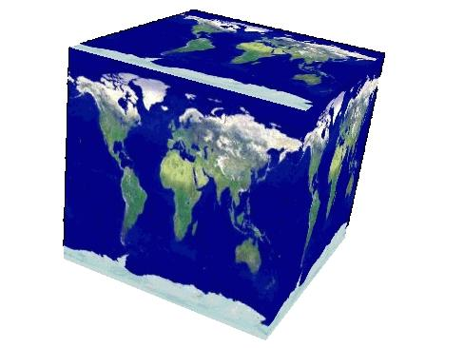
3D EFFECTS EXAMPLE: TEXTURE MAPPING

Slide 24
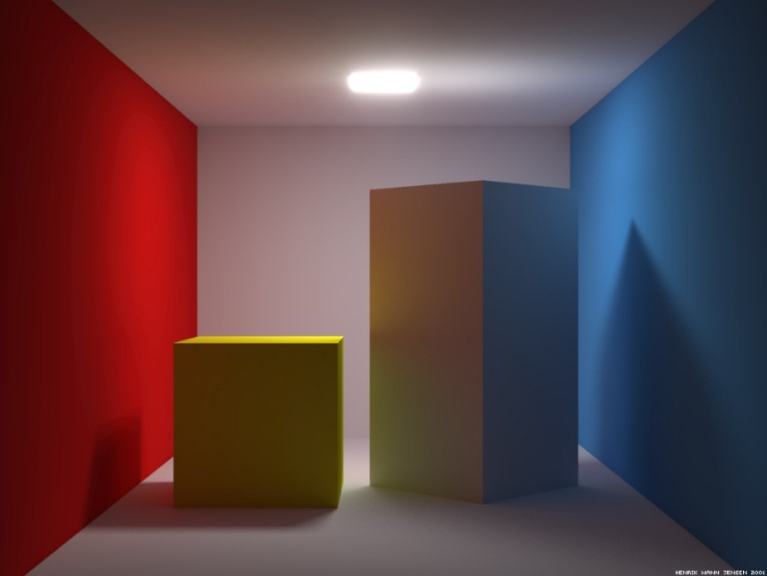
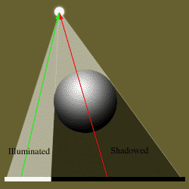
3D EFFECTS EXAMPLE: SHADOWS

Slide 25
ANIMATION
Is the process used for moving or simulating the movement of object over time
Temporal change of
Objects (position, orientation, size, shape, color, etc.)
Camera (position, direction, angle, focus, etc.)
Illumination (position, direction, color, brightness)
Represent motion
Sequence of silent
Parameter curves

Slide 26
APPLICATIONS OF COMPUTER GRAPHICS
Entertainment:
Movies, Video games
Graphical user interface (GUI)
Web Page interface, desktop application Interface
Computer aided design(CAD)
Mechanical, Electronic design
Medical Application
Engineering
Scientific visualization / simulation
Enable scientists (also engineers, physicians, and general users) to observe their simulation and computation

Slide 27
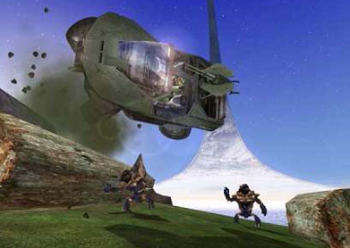
ENTERTAINMENT
Movie
There is No interactivity between user and Computer,
sequence of frames.
Games

Slide 28
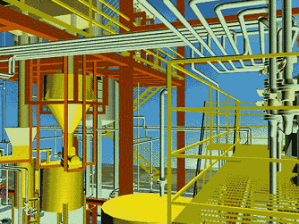
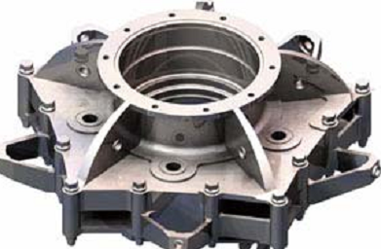
COMPUTER AIDED DESIGN(CAD)

Slide 29
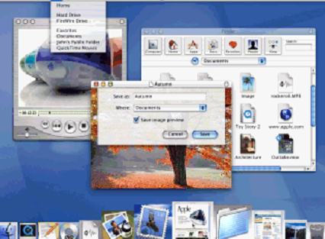
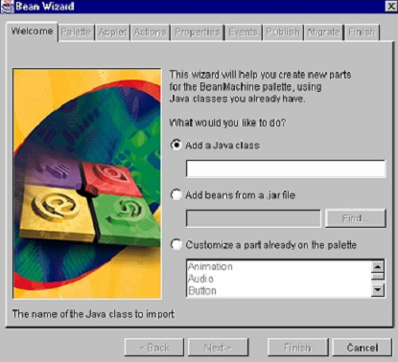
GRAPHICAL USER INTERFACE (GUI)

Slide 30
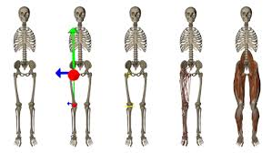
MEDICAL APPLICATIONS
Training, education
Creation of complete, anatomically detailed 3D representation of human bodies

Slide 31
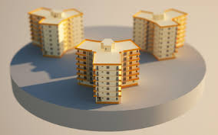
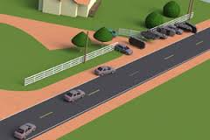
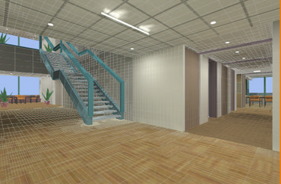
ENGINEERING

Slide 32
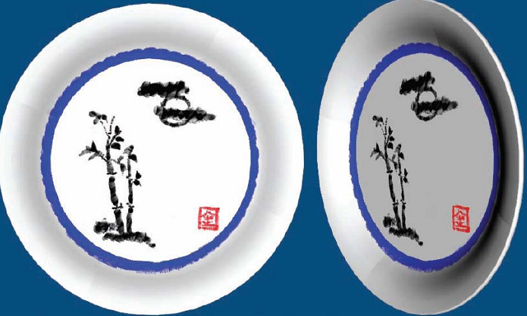
COMPUTER ART
Poster Design
Book Hard Cover Design
3d Product Box Design

Slide 33
PIXELS AND IMAGES
The image is an array—the raster—of picture elements, or pixels, produced by the graphics system.
Resolution—the number of pixels in the horizontal direction times the number of pixels in the vertical direction in an image.
The depth, or precision, is the number of bits that are used for each pixel, determines properties such as how many colors can be represented on a given system.

Slide 34
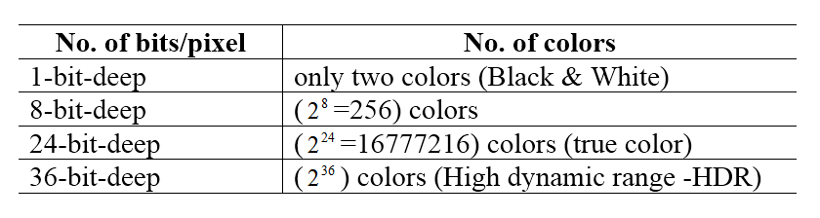
PIXELS AND IMAGES

Slide 35
SCREEN ”RESOLUTION”
The more pixels, the more information is visible without scrolling.
It is usually quoted as width × height, with the units in pixels:
Example:
"1024 × 768" means the width is 1024 pixels and the height is 768 pixels
VGA 640 480
SVGA 800 600
Aspect ratio: is the ratio of image’s width to its height.
Frame aspect ratio = Width/ Height
TV 4 : 3
HDTV 16 : 9

Slide 36
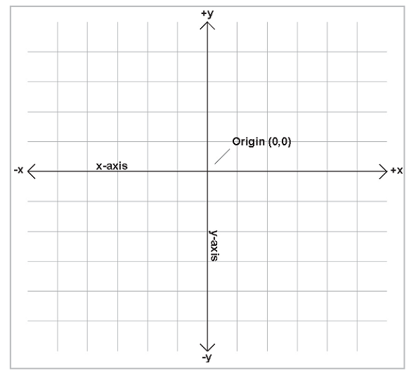
2D CARTESIAN COORDINATE SYSTEM

Slide 37
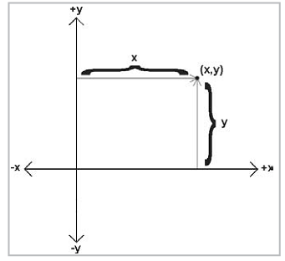
LOCATE A POINT USING 2D CARTESIAN

Slide 38
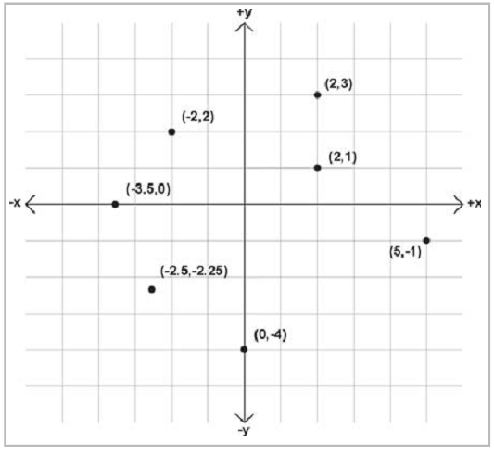
EXAMPLE POINTS LABELED WITH 2D CARTESIAN COORDINATES

Slide 39
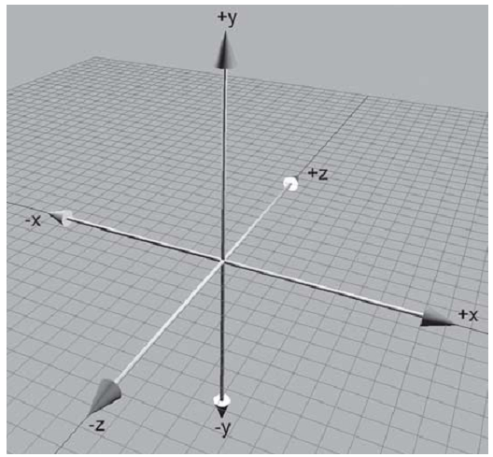
3D CARTESIAN COORDINATE SYSTEM

Slide 40
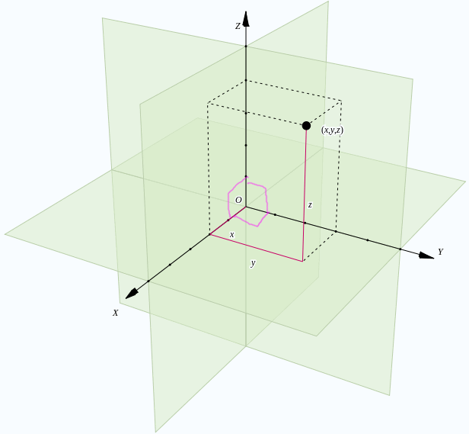

Slide 41
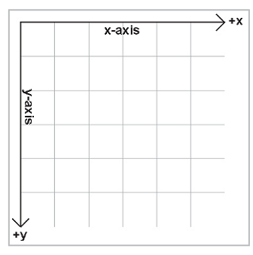
SCREEN COORDINATE
10
9
8
7
6
5
4
3
2
1
0
0
1
2
3
4
5
6
7
8
9
10

Slide 42
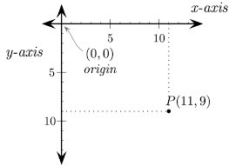
SCREEN COORDINATE

Slide 43
SCREEN COORDINATE
10
9
8
7
6
5
4
3
2
1
0
0
1
2
3
4
5
6
7
8
9
10

Slide 44
POSITIONING SYSTEM
Absolute Position
Refers to a specific position in the screen
For example in HTML 5 moveTo(3,12), refer to location in the screen in 3 x axis and 12 y axis
This type is related to Point in linear algebra
Relative Position
Refer to the new position according to the position of another object
The position of something is specified by describing where it is in relation to some other known location
For example the chair is far from table by 12 pixel east and 15 pixel north
This type is related to vector definition that represents displacement from one object to another object

Slide 45
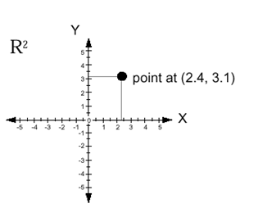
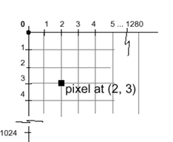
COORDINATE SYSTEMS
Cartesian coordinates
Display (physical) coordinates

Slide 46
INTERACTIVE AND PASSIVE GRAPHICS
(a) Non-Interactive or Passive Computer Graphics: | (b) Interactive Computer Graphics:
In non-interactive computer graphics, the picture is produced on the monitor, and the user does not have any control over the image, i.e., the user cannot make any change in the rendered image. One example of its Titles shown on T.V. | In interactive Computer Graphics users have some control over the picture, i.e., the user can make any change in the produced image. One example of it is the ping-pong game.
Non-interactive Graphics involves only one-way communication between the computer and the user, User can see the produced image, and he cannot make any change in the image. (Ex. movies) | Interactive Computer Graphics requires two-way communication between the computer and the user. A User can see the image and make any change by sending his command with an input device.(Ex. games)

Slide 47
ENABLING MODERN COMPUTER GRAPHICS (1)
Hardware revolution
Moore’s Law: every 12-18 months, computer power improves by factor of 2 in price / performance as size shrinks
Newest CPUs are 64-bit with 4, 8, 16, even 56 cores
Intel Coffee Lake – a processor with up to 8 cores, 16 threads, and a fully featured graphics chip built in to the processor

Slide 48
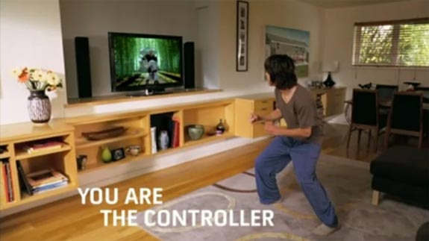
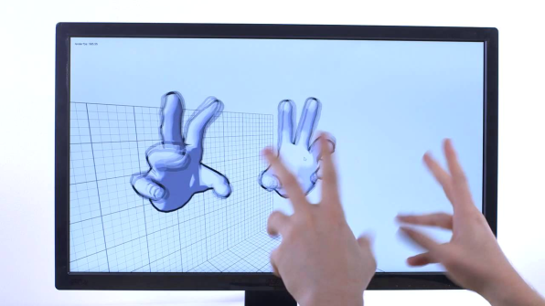
ENABLING MODERN COMPUTER GRAPHICS (2)
Input Devices
Mouse, tablet & stylus, multi-touch, force feedback, and other game controllers (e.g., JoyCon for Nintendo Switch), scanner, digital camera (images, computer vision), etc.
Body as interaction device
http://youtu.be/zXghYjh6Gro
Kinect is not as relevant anymore commercially b/c VR is more immersive
Xbox Kinect:
Leap Motion:

Slide 49
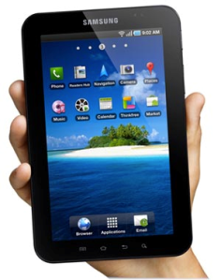
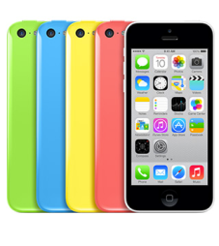
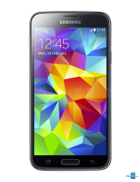
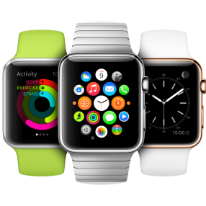







ENABLING MODERN COMPUTER GRAPHICS (3)
Many form factors
Smartphones/laptops/desktops/tablets
Smart watches
Head-mounted displays (HMDs)
HTC Vive
Augmented Reality
Virtual Reality
AR vs VR: Different experiences!
Apple iPhone
Android Phones
Tablets
Microsoft’s first Surface
Apple Watch
Android Wear
Vive Focus
Oculus Rift
Google Cardboard
Brown’s old Cave
Microsoft Hololens
Notes:
Htc vive from 2016

Slide 50



DIGRESSION: AUGMENTED REALITY
Easily accessible AR through smartphones
Advanced AR through Microsoft Hololens 2
https://youtu.be/tYPlodStLTc?t=16
New Trailer
Live Demo

Slide 51
ENABLING MODERN COMPUTER GRAPHICS (5/5)
Software Improvements
Algorithms and data structures
Modeling of materials
Rendering of natural phenomena
“Acceleration data structures” for ray tracing and other renderers
Parallelization
Most operations are embarrassingly parallel: calculating value of one pixel is often independent of other pixels
Distributed and Cloud computing
Send operations to the cloud, get back results, don’t care how
Rendering even available as internet service!

Slide 52



GRAPHICS DISPLAY HARDWARE
Vector (calligraphic, stroke, random-scan)
Raster (TV, bitmap, pixmap) used in displays and laser printers
Driven by display commands
(move (x, y), char(“A”) , line(x, y)…)
Survives as “scalable vector graphics”
Driven by array of pixels (no semantics, lowest form of representation)
Note “jaggies” (aliasing errors) due to discrete sampling of continuous primitives
Ideal Drawing
Vector Drawing
Outline
Filled

Slide 53

CONCEPTUAL FRAMEWORK FOR INTERACTIVE GRAPHICS
Software
Hardware
Graphics
System/
GPU
Graphics
Library
Application
program
Application
Model / database
Graphics library/package is intermediary between application and display hardware (Graphics System)
Application program maps application objects to views (images) of those objects by calling on graphics library. Application model may contain lots of non-graphical data (e.g., non-geometric object properties)
User interaction results in modification of image and/or model
This hardware and software framework is 5 decades old but is still useful

Slide 54
GRAPHICS LIBRARY
Examples:
OpenGL™,
HTML5 + WebGL™
Unity 2D/3D
Three.JS
Primitives (characters, lines, polygons, meshes,…)
Attributes
Color, line style, material properties for 3D
Lights
Transformations
Caching and Performance optimization
Notes:
DAG = directed acyclic graph

Slide 55


APPLICATION DISTINCTIONS: TWO BASIC PARADIGMS
Sample-based graphics vs Geometry-based graphics

Slide 56
SAMPLE-BASED GRAPHICS (1/3)
Sample-based graphics: Discrete samples are used to describe visual information
pixels can be created by digitizing images, using a sample-based “painting” program, etc.
often some aspect of the physical world is sampled for visualization, e.g., temperature across the US
example programs: Adobe Photoshop™, GIMP™ , Adobe AfterEffects™ (which came out of CS123/CS224!)

Slide 57

SAMPLE-BASED GRAPHICS (2/3)
Pixels are point locations with associated sample values, usually of light intensities/colors, transparency, and other control information
When we sample an image, we sample the point location along the continuous signal and we cannot treat the pixels as little circles or squares, though they may be displayed as such

Slide 58
SAMPLE-BASED GRAPHICS (3/3)
Samples created directly in Paint-type program, or by sampling of continuous (analog) visual materials (light intensity/color measured at regular intervals) with many devices including:
Sample values can also be input numerically (e.g., with numbers from computed dataset)
Once an image is defined as pixel-array, it can be manipulated
Image editing: changes made by user, such as cutting and pasting sections, brush-type tools, and processing selected areas
Image processing: algorithmic operations that are performed on image (or pre-selected portion of image) without user intervention. Blurring, sharpening, edge-detection, color balancing, rotating, warping. These are front-end processes to Computer Vision, Computational Photography

Slide 59



SAMPLING AN IMAGE
Lets do some sampling of CIT building
A color value is measured at every grid point and used to color corresponding grid square
Crude sampling and image reconstruction method creates blocky image
3D scene
0 = white, 5 = gray, 10 = black

Slide 60


WHAT’S THE ADVANTAGE?
Once image is defined in terms of colors at (x, y) locations on grid, can change image easily by altering location or color values
E.g., if we reverse our mapping above and make 10 = white and 0 = black, the image would look like this:
Pixel information from one image can be copied and pasted into another, replacing or combining with previously stored pixels

Slide 61
WHAT’S THE DISADVANTAGE?
WYSIAYG (What You See Is All You Get): No additional information
No depth information; depth sensors can be used in conjunction
Can’t examine scene from different point of view
At most can play with the individual pixels or groups of pixels to change colors, enhance contrast, find edges, etc.

Slide 62
GEOMETRY-BASED GRAPHICS (2/2)
Geometry-based graphics applications
Store mathematical descriptions, or “models,” of geometric elements (lines, polygons, polyhedrons, polygonal meshes…) and associated attributes (e.g., color, material properties).
Geometric elements are called primitive shapes, primitives for short.
Images are created via sampling of geometry for viewing, but not stored as part of model.
Users cannot usually work directly with individual pixels in geometry-based programs; as user manipulates geometric elements, program resamples and redisplays elements
Increasingly, rendering combines geometry- and sample-based graphics, both as performance hack and to increase quality of final product
CG animated characters (geometry) on painted or filmed scene images (samples)

Slide 63
BIT DEPTH
Image files are often referred to by the number of bits used to store color information
A bit is a piece of binary data (meaning that it has only two possible values).
It can be a one or a zero, true or false, yes or no
It can be combined with other bits to produce a range of numbers

Slide 64
BIT DEPTH
One bit = two possible values (0, 1)
Two bits = four values (00, 01, 10, 11)
Three bits = eight values (000, 001, 010, 011, 100, 101, 110, 111)
So, the number of possible values is 2^{n}
where n is the number of bits per pixel
Therefore, eight bits give 256 potential values
Eight bits is one byte, so that is a common image format

Slide 65
BIT DEPTH
Eight-bit images can be color or “grayscale”
With grayscale, the values vary continuously from
0 (black) to 255 (white)
With eight bit color, the colors are normally indexed.
This means there is a look-up table containing RGB values for all the colors you want to show. This can be limiting, however.

Slide 66
COLOR DEPTH
Color depth: the number of colors in an image.
The more colors the image uses, the more colors that the image needs to keep track of, and the more bits that are needed to store each pixel.

Slide 67
CHANGING COLOR DEPTH
For a bitmap or raster image, changing the color depth changes the size of the file by a precise predictable amount, e.g.:
A 1 bit (black and white) image is one eighth the size of 8 bit
A 8 bit is one third the size of 24 bit
With compression, these ratios can vary, but they’re still a good rule of thumb

Slide 68

8 BIT COLOR 261X275 PIXELS, 38 KB GIF

Slide 69

4 BIT COLOR 261X275 PIXELS, 13 KB GIF

Slide 70

2 BIT COLOR 261X275 PIXELS, 5 KB GIF

Slide 71

1 BIT COLOR 261X275 PIXELS, 2 KB GIF

Slide 72
HOW RASTER IMAGE STORE PIXELS COLORS?
The are 2 techniques:
Indexed Color Images
True Color Image

Slide 73

INDEXED COLOR IMAGES
Indexed color images use a so-called lookup table with a limited amount of colors.
The maximum amount of colors in GIF images is, for example, 256.
Every single pixel in a GIF image uses an index to designate its color. The index points to a specific color in the lookup table.
By changing a color in the lookup table, all pixels with the same index will automatically change color.
https://drububu.com/tutorial/image-types.html

Slide 74

TRUE COLOR IMAGES
Compared to indexed color images, true color images lack a color lookup table. A pixel doesn't have an index referring to a specific color in the color lookup table. Every pixel has it's own (RGB) color-value, and, depending on the file format, a value for transparency (RGBA).
https://drububu.com/tutorial/image-types.html

Slide 75
IMAGE REPRESENTATION
In the world of digital imaging, there are two types of graphical image files that you need to be aware of:
Raster Image
Vector Image

Slide 76
RASTER AND VECTOR FORMATS

Slide 77
Image File Formats Explained
There are 2 main graphic file formats:
Raster Formats (JPEG, BMP, TIFF, GIF, PNG, WebP, *PDF)
Vector Formats (AI, SVG, EPS, *PDF)
Note: There are new image formats being created every day for new and specific purposes.
*PDF’s can be either Raster OR Vector

Slide 78
Raster Formats
Raster images are also called bitmap images because they are made up of tiny squares called pixels; each ‘pixel’ contains exactly 1 color.
Pros of Raster Formats
Rich Detail: Ever wondered what the term “dpi” stands for? It means “dots per inch,” a measurement of how much detailed color information a raster image contains.
Say you’ve got a 1” x 1” square image at 300 dpi—that’s 300 individual squares of color that provide precise shading and detail in your photograph. The more dpi your image contains, the more subtle details will be noticeable.

Slide 79
Image File Formats Explained
Raster Formats
Pros of Raster Formats
Precise Editing: All of those individual pixels of color information can also be adjusted, one by one. So if you’re some type of perfectionist, the level of editing and customization available in a raster image is almost unlimited.

Slide 80
Image File Formats Explained
Raster Formats
Cons of Raster Formats
Blurry When Enlarged: The biggest downfall to raster images is that they become pixelated (aka grainy) when enlarged. Why is this? Well, there are a finite number of pixels in all raster images; when you enlarge a photo, the computer takes its best guess as to what specific colors should fill in the gaps. This interpolation of data causes the image to appear blurry since the computer has no way of knowing the exact shade of colors that should be inserted.

Slide 81
Image File Formats Explained
Raster Formats
Cons of Raster Formats
Large File Size: Remember how a 1” x 1” square at 300 dpi will have 300 individual points of color information for the computer to remember? Well let’s say you have an 20” x 20” photo— that’s 120,000 bits of information for a computer to process which can quickly slow down even a fast computer.

Slide 82
Image File Formats Explained
Raster Formats
JPEG
JPEG (Joint Photographic Experts Group) is a *lossy compression method. Supports eight-bit grayscale images and 24-bit color images (eight bits each for red, green, and blue.) JPEG applies a lossy compression to images which can result in a significant reduction of the file size.
Keep in mind JPEG files suffer degradation when repeatedly edited and saved (it loses picture quality).
Recommended Use: When file size is more important than image quality. An example would be trying to save storage space on a website.
*lossy compression is the class of data encoding methods that uses inexact approximations to represent content. Hence, there will be “loss” in exact quality.

Slide 83
Image File Formats Explained
Raster Formats
BMP
The BMP file format (Windows bitmap) handles graphic files within the Microsoft Windows OS. Typically, BMP files are uncompressed, and therefore large and lossless; their advantage is their simple structure and wide acceptance in Windows programs.
Recommended Use: Large files (uncompressed), was used mostly for printing.

Slide 84
Image File Formats Explained
Raster Formats
GIF
GIF (Graphics Interchange Format) is for common usage limited to an 8-bit palette, or 256 colors (while 24-bit color depth is possible).
The GIF format is most effective for storing graphics with few colors, such as simple diagrams, shapes, logos and cartoon style images, as it uses LZW lossless compression which is more effective when large areas have a single color, and less effective for images. Due to the GIF's format simplicity and age, it has almost universal software support. Because of its included animation capabilities, it is still widely used to provide image animation effects, despite its low compression ratio in comparison to modern video formats.
Recommended Use: GIF can make flawless copies at a high compression as long as the image contains large areas of uniform color, as long as the image has no more than 256 colors.

Slide 85
Image File Formats Explained
Raster Formats
PNG
PNG (Portable Network Graphics) is a raster graphics file format that supports lossless data compression. PNG was created as an improved, non-patented replacement for Graphics Interchange Format (GIF), and is the most used lossless image compression format on the Internet.
Recommended Use: PNG was designed for transferring images on the Internet, not for professional-quality print graphics, and therefore does not support non-RGB color spaces such as CMYK.

Slide 86
Image File Formats Explained
Vector Formats
Vector Formats
Vector images are the No. 1 option when designing or creating a logo or illustration. Because of the way images are created and saved, you will have more flexibility with making changes and be able to use your image at a variety of sizes.
You may only need a web logo now, but imagine how great it would be to have that image ready to use on a banner or merchandise later without having to create it all over again?

Slide 87
Image File Formats Explained
Vector Formats
Pros of Vector Formats
Scalability: Vector data can be easily scaled and otherwise manipulated to accommodate the resolution of a spectrum of output devices. In simple terms: you can change the size and height/width ratio of the image without compromising the image quality.
Ease of Editing: Because every element in a vector file originated as a separate object it is very easy to edit!

Slide 88
Image File Formats Explained
Vector Formats
Pros of Vector Formats
High Quality: The nature of vector files allows for almost zero pixilation when scaling the image.

Slide 89
Image File Formats Explained
Vector Formats
Cons of Vector Formats
Hard Time Storing Complex Images: Vector files cannot easily be used to store extremely complex images, such as some photographs, where color information is paramount and may vary on a pixel-by-pixel basis.
Display Software: High-resolution raster displays are needed to display vector graphics as effectively.

Slide 90
Image File Formats Explained
Vector Formats
Cons of Vector Formats
Expensive Software: Vector images can only be created using certain software: Adobe (Illustrator, InDesign, and Photoshop), Inkscape, DrawIT (Mac), Scribus, and Corel to name a few.

Slide 91
Image File Formats Explained
Vector Formats
SVG
SVG (Scalable Vector Graphic) is the description of an image as an application of the Extensible Markup Language (XML). Any program such as a Web browser that recognizes XML can display the image using the information provided in the SVG format.
The SVG format enables the viewing of an image on a computer display of any size and resolution.
Recommended Use: Displaying images on screens (computers, lcd, smart phones, etc.)

Slide 92

Image File Formats Explained
Vector
Raster
PDF
PDF (Portable Document Format) in its simplest sense, is a file format used to present documents in a manner independent of application software, hardware, and operating systems.
A PDF can either be a Vector OR Raster file!
An easy way to see if your PDF file contains vector or bitmap content is to magnify the drawing to more than 800%. If you see smooth curves and straight lines, it’s a vector file. If what you see on screen looks jagged, ragged or pixelated, it is a bitmap file (raster).
Recommended Use: When you want to present a file to someone that CAN’T be edited.

Slide 93
BITMAP OR VECTOR GRAPHIC?
When deciding whether an image should be a bitmap or vector graphic, you should ask yourself the following questions:
Does the image need to be resized?
Does the image need to be drawn or scale?
Do you need the image to look real?
Do you have any restrictions on the file size?

Slide 94
CHANGING RESOLUTION
It is possible to greatly reduce the size of an image by reducing the number of pixels used to represent the image
Size savings are squared; i.e. if you reduce an image from 200x200 (40,000 pixels) by half to 100x100 (10,000 pixels), the size savings is actually 1/2 * 1/2 = 1/4

Slide 95
8 BIT COLOR 261X275 PIXELS, 38 KB GIF

Slide 96

8 BIT COLOR ~130X137 PIXELS, 9KB GIF

Slide 97

8 BIT COLOR ~65X68 PIXELS, 3KB GIF

Slide 98
COMPRESSION
Often, it is desirable to apply a compression algorithm to an image to reduce the file size

Slide 99

JPEG IMAGE, QUALITY 85; 59 KB

Slide 100

GIF IMAGE (8 BIT COLOR) 113 KB (DEPENDING ON ENCODING, PNG WOULD BE PERFECT BUT UP TO 6X AS BIG)

Slide 101
COMPRESSION EXAMPLES
Images taken from
Edward Fox, 2003. CS 4624 course site
(http://ei.cs.vt.edu/~mm/gifs/jpgs.html)
Watch the sizes as we go:
Original image (taken by H. Rex Hartson) is
as a 24-bit bitmap image
804 kb

Slide 102

ORIGINAL (804 KB BITMAP)
Notice the difference
Between Images

Slide 103

GIF - 259 KB (8 BIT COLOR)
Notice the difference
Between Images

Slide 104
JPEG - QUALITY 100 - 326 KB
Notice the difference
Between Images

Slide 105

JPEG - QUALITY 75 - 71 KB
Notice the difference
Between Images

Slide 106

JPEG - QUALITY 50 - 46 KB
Notice the difference
Between Images

Slide 107

JPEG - QUALITY 25 - 29 KB
Notice the difference
Between Images

Slide 108

JPEG - QUALITY 10 - 15 KB
Notice the difference
Between Images

Slide 109

JPEG - QUALITY 5 - 9 KB
Notice the difference
Between Images

Slide 110
TRANSPARENCY
Some images include information on transparency encoded into the image.
GIF images may include one transparent color in the color index table, allowing one “color” of the image to be transparent.
PNG images can be indexed or true color and may include an additional byte of information per color (the alpha channel), which determines how transparent a particular pixel or color is.
Native computer graphics formats are often 32-bit color – one byte each for RGB plus an additional byte for transparency or “alpha”

Slide 111
TRANSPARENCY
Faked “transparency”: the image is created and saved on a background to match the web page background.
Not always a perfect match on older computers or on jpegs.

Slide 112
TRANSPARENCY
Real transparency: the image background is transparent, so the image floats on the web page background color.
Especially useful for patterned web page backgrounds.
Use the web page background color as the image background color while creating the image, but turn on transparency before saving the image to the web.

Slide 113
ASPECT RATIO
Aspect Ratio: Ratio of width to height.
Never change the aspect ratio of a photo – it distorts the image.

Slide 114



ASPECT RATIO
Bad examples:

Slide 115


ASPECT RATIO
Good examples of resizing:
Resize, maintaining aspect ratio
Crop to eliminate unnecessary background

Slide 116
COMPONENTS OF COMPUTER GRAPHICS SYSTEM
Input Devices
Keyboard, Mouse, Joystick, Touch Screen,….
Data
Image
Processing
CPU, GPU
Storage
Frame buffer
Output devices
CRT, LCD, Touch Screen
Computer Graphics Software

Slide 117

CG APPLICATION LIFECYCLE

Slide 118
CPU AND GPU
The main graphical function of the processor is to take specifications of graphical primitives (such as lines, circles, and polygons) generated by application programs and to assign values to the pixels in the frame buffer that best represent these entities.
The conversion of geometric entities to pixel colors and locations in the frame buffer is known as rasterization, or scan conversion.
Today, virtually all graphics systems are characterized by special-purpose graphics processing units (GPUs), custom-tailored to carry out specific graphics functions.
The frame buffer is accessed through the graphics processing unit and usually is on the same circuit board as the GPU.

Slide 119

PROCESSING DEVICE
Video adapter.

Slide 120
GPU
A graphics card's processor, called a graphics processing unit (GPU), is similar to a computer's CPU.
A GPU, however, is designed for performing the complex mathematical and geometric calculations that are necessary for graphics rendering.
GPU is responsible for digitizing a picture given in application into a set of pixel- intensity values for storage in the frame buffer.
Process geometry/pixels and produce images to be displayed on the screen
Recent GPUs contain over 100 processing units, each of which is user programmable.

Slide 121
FRAME BUFFER
Frame buffer: the memory to hold the pixel properties
(color, alpha, depth, stencil mask, etc)
Properties of a frame buffer that affect the graphics performance:
Size: screen resolution
Depth: color level
1 bit/pixel: black and white
8 bits/pixel: 256 levels of gray or color pallet index
24 bits/pixel: 16 million colors
Speed: refresh speed
Typically the frame buffer is stored in the memory chips on the video adapter.
In some instances, however, the video chipset is integrated into the motherboard design, and the frame buffer is stored in general main memory.

Slide 122

OUTPUT DEVICES- CATHODE-RAY TUBE(CRT)

Slide 123
CRT
CRT monitors produce images using the same technology as an ordinary television.
A CRT monitor consists of an electron gun which emits a beam of electrons to the screen.
When the electron beam strikes the coating of phosphor dots on the screen, the energy of the electrons is transferred to the phosphor and a dot of red, green or blue light is produced.
There are devices in a CRT monitor to change the strength of the electron beam, and to control the electron beam to sweep across the whole area of the screen very rapidly.
By changing the strength of the electron beam striking at different positions on the screen, dots of different colors and brightness are produced on the screen, and these dots combine to form the color image seen on a CRT monitor.

